Slide 1
FULL-BLEED IMAGE SLOT (Genoa / Italian Riviera hero)
A Transatlantic Opportunity:
New York from Genoa
Aeroporto di Genova Cristoforo Colombo | Genoa - New York | Airbus A321XLR
World Routes 2026
Prepared by Avia Solutions | June 2026
[ Airport logo ] [ Avia Solutions logo ] [ Airline logo ]

Slide 2
A Transatlantic Opportunity: New York from Genoa
World Routes 2026
Contents
1
Summary of Route Forecast
4
2
Why New York from Genoa
5
3
The Case and the Precedent
9
4
Genoa - New York Forecast
13
5
Revenue and Economics
17
6
Genoa Airport
19
7
Appendix: Methodology
21
AviaSolutions analysis
[ Airline logo ]
1

Slide 3
A Transatlantic Opportunity: New York from Genoa
World Routes 2026
Genoa is well placed to anchor a New York service for Liguria
New York holds the largest Italian-American population on earth: circa 2.6m in the metro, circa 6.3m across the US northeast.
Liguria set a tourism record in 2024 at 16.2m arrivals, led by foreign demand, with the Cinque Terre and Portofino within an hour of the airport.
The US is Italy's premium inbound market: circa 4.1m travellers spending over EUR 6.6bn in 2025, the highest per-night spend of any nationality.
Genoa is a major cruise homeport: circa 620,000 air-relevant embarkation passengers a year.
The catchment generates circa 553,300 New York passengers a year, almost all leaking out through Milan today.
The A321XLR makes a thin transatlantic market viable, and United is already opening Newark nonstops to secondary Italian cities.
A daily aircraft fills in peak season; a seasonal, building pattern is the prudent launch.
Honest read: a mainly point-to-point leisure and VFR market, thinner than a hub route, with a modest business layer.
Source: AviaSolutions analysis; US Census ACS 2024; Regione Liguria; Bank of Italy; Ports of Genoa (2024-2026)
AviaSolutions analysis
[ Airline logo ]
2

Slide 4
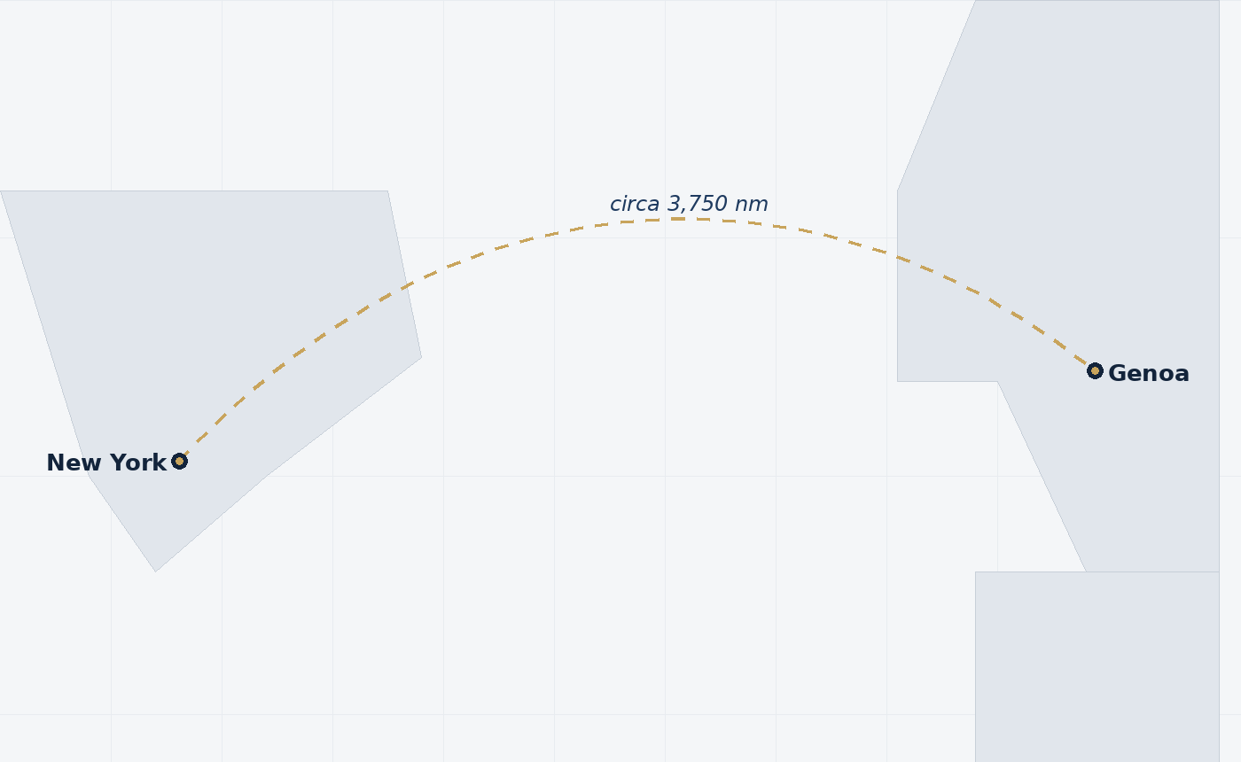
A Transatlantic Opportunity: New York from Genoa
World Routes 2026
Opportunity at Genoa: Summary of Route Forecast
553,300
New York O&D market
62,600
Recaptured by a Genoa nonstop
Limited
Connecting market
* Each way, based on AviaSolutions' Genoa catchment analysis.
Schedule Options: Airbus A321XLR
Sector | Dep. | Arr. | Op. Days | Aircraft | Seats | Annual Seats | Annual Pax | Seat Factor
GOA-JFK | 10:30 | 14:00 | Seasonal | A321XLR | 182 | 66,248 | 62,600
JFK-GOA | 19:00 | 08:30 | Seasonal | A321XLR | 182 | 66,248 | 62,600
Total |  |  | Building | A321XLR |  | 132,496 | 125,200 | circa 90%
AviaSolutions analysis
[ Airline logo ]
3

Slide 5
FULL-BLEED IMAGE SLOT (San Jose / Silicon Valley)
Section 2
Why New York from Genoa

Slide 6
A Transatlantic Opportunity: New York from Genoa
World Routes 2026
The largest Italian-American market on earth
A deep, year-round visiting-friends base
Italian-American population by US metro (millions)
circa 2.6m
Italians in the New York metro
The largest of any US metro
The New York region holds the densest Italian-American population anywhere outside Italy, circa 39% of the US total across the northeast.
A resilient, year-round visiting-friends-and-relatives base, less seasonal and less price-sensitive than pure leisure.
Genoa carries a direct hook: the city is the birthplace of Christopher Columbus, the figure at the centre of New York's Italian-American identity.
Source: US Census Bureau ACS 2024 (B04006); ENIT / ForwardKeys (2026)
AviaSolutions analysis
[ Airline logo ]
5

Slide 7
A Transatlantic Opportunity: New York from Genoa
World Routes 2026
A record tourism region and a premium US market
High-spend, long-stay leisure demand
16.2m
circa 4.1m
EUR 191
Liguria arrivals, 2024
US travellers to Italy
US spend per night
An all-time record, foreign-led
Spending over EUR 6.6bn in 2025
The highest of any nationality
The region packs world-class draws within an hour of the airport: the Cinque Terre, Portofino, the Riviera and a UNESCO-listed historic centre.
Genoa was Lonely Planet's only Italian Best in Travel city for 2025, fresh visibility in the US market.
US traffic to Southern Europe runs circa 27% above 2019; the profile is long-stay (8-10 nights) and 88% leisure.
Source: Regione Liguria Tourism Observatory (2025); ENIT / Bank of Italy (2026); Lonely Planet 2025
AviaSolutions analysis
[ Airline logo ]
6

Slide 8
A Transatlantic Opportunity: New York from Genoa
World Routes 2026
A major cruise homeport
Air-relevant embarkation demand on top of leisure
Genoa is the seventh-largest cruise port in the Mediterranean, circa 1.6m cruise passengers in 2025.
Of these, circa 620,000 are homeport passengers who travel to or from Genoa, many by air.
Genoa is the home of Costa Cruises and an MSC base; MSC already sells flight-inclusive packages with a Genoa airport lounge.
The United States is the world's largest cruise source market, so a New York nonstop strengthens Genoa as a transatlantic embarkation port.
circa 620,000
air-relevant cruise pax
Homeport passengers, 2025
IMAGE SLOT
Genoa cruise terminal / ship
airport / library image
Source: Risposte Turismo / Seatrade (2026); Ports of Genoa; MSC Cruises
AviaSolutions analysis
[ Airline logo ]
7

Slide 9
FULL-BLEED IMAGE SLOT (San Jose / Silicon Valley)
Section 3
The Case and the Precedent

Slide 10
A Transatlantic Opportunity: New York from Genoa
World Routes 2026
The A321XLR makes a thin route viable
The aircraft that opens secondary-city transatlantic markets
4,700nm
circa 182
2025-26
A321XLR range
seats
transatlantic entry
Genoa to New York is circa 3,750nm
A fraction of a widebody's demand need
Aer Lingus, Iberia, JetBlue, United
The A321XLR carries circa 180 to 200 passengers across the Atlantic, opening routes no widebody could fill daily.
Genoa to New York is comfortably inside the type's range, and the runway and apron handle the aircraft without constraint.
United took its first A321XLR at Newark in June 2026, the natural operator for this route.
Source: Airbus; AeroXplorer (United XLR, Jun 2026); The Points Guy
AviaSolutions analysis
[ Airline logo ]
9

Slide 11
A Transatlantic Opportunity: New York from Genoa
World Routes 2026
The precedent: United's secondary-Italy nonstops
A proven template that Genoa fits precisely
City | Route | Status | Frequency
Naples | Newark, plus Chicago and Atlanta | Established, expanded 2024-2025 | Up to twice daily
Palermo | Newark (United, only US carrier) | Launched May 2025 | 3 weekly, building
Bari | Newark (United, only US carrier) | Launches May 2026 | 4 weekly, Boeing 767
Genoa | New York (proposed) | The opportunity | Seasonal, building
United is systematically opening Newark nonstops from secondary European cities (Palermo, Bari, Glasgow, Bilbao) at 3 to 4 weekly. Genoa is a mid-sized Italian city with strong US leisure demand and no incumbent nonstop: the same case.
Source: Air Service One (May 2025); AFAR citing United (Oct 2025)
AviaSolutions analysis
[ Airline logo ]
10

Slide 12
A Transatlantic Opportunity: New York from Genoa
World Routes 2026
Seasonality: a summer-led, building pattern
Why a seasonal launch is the prudent base case
Mediterranean leisure demand is highly seasonal, peaking June to September.
The prudent launch mirrors United's secondary-Italy routes: seasonal, late April to October.
Year-round service would lean on the visiting-friends and business layers, which are real but thinner.
Source: AviaSolutions analysis; Eurostat seasonality (2025). Monthly profile illustrative.
AviaSolutions analysis
[ Airline logo ]
11

Slide 13
FULL-BLEED IMAGE SLOT (San Jose / Silicon Valley)
Section 4
Genoa - New York Forecast

Slide 14
A Transatlantic Opportunity: New York from Genoa
World Routes 2026
The catchment and the leak to Milan
Genoa's New York demand drives two hours to Malpensa today
The Genoa catchment generates circa 553,300 two-way passengers a year to New York, but almost none flies from Genoa.
With no nonstop, Liguria passengers drive circa two hours to Milan Malpensa, or connect over Rome, Munich or Amsterdam.
Milan Malpensa runs circa four daily New York nonstops; that is the pool a Genoa service would partly recapture.
Recapturing local demand onto a local nonstop is the core of the case, the same logic that built United's secondary-Italy routes.
circa 198 km
Genoa to Malpensa
A two-hour drive each way
circa 4 daily
Milan - New York nonstops
The leakage a Genoa service recaptures
Source: AviaSolutions QSI catchment model; OAG
AviaSolutions analysis
[ Airline logo ]
13

Slide 15
A Transatlantic Opportunity: New York from Genoa
World Routes 2026
Route Forecast: recapturing the leakage
What a daily A321XLR can carry
Demand layer | Passengers (each way) | Note
Natural catchment demand to New York | circa 92,500 | Genoa's own addressable market
Captured at Genoa today | circa 7,000 | Almost all leaks to Milan
Leaked pool a nonstop can win | circa 85,500 | Demand driving past Genoa
Repatriated at 65% capture | circa 55,600 | Bounded, conservative capture
Genoa nonstop forecast | circa 62,600 | Captured plus repatriated
Note: Genoa is a point-to-point market. Unlike a hub route there is little connecting demand to tabulate beyond New York or beyond Genoa, so the forecast rests on catchment recapture and stimulation.
Source: AviaSolutions QSI catchment and repatriation model (Sabre O&D)
AviaSolutions analysis
[ Airline logo ]
14

Slide 16
A Transatlantic Opportunity: New York from Genoa
World Routes 2026
Forecast detail by cabin
Revenue quality on a leisure-led market
Cabin | Demand (each way) | Share | One-way fare | Share of revenue
Economy | circa 50,100 | 80% | circa $345 | circa 50%
Business | circa 12,500 | 20% | circa $1,400 | circa 50%
Total each way | circa 62,600 | 100% |  | 100%
circa 125,200
182 seats
circa 90%+
annual passengers
Airbus A321XLR
peak load factor
Both directions combined
20 business, 162 economy
Demand fills the aircraft in season
Business is one in five passengers but circa half of ticket revenue, the quality that supports a premium single-aisle cabin.
Source: AviaSolutions revenue model; cabin split from the Genoa case. Illustrative.
AviaSolutions analysis
[ Airline logo ]
15

Slide 17
FULL-BLEED IMAGE SLOT (San Jose / Silicon Valley)
Section 5
Revenue and Economics

Slide 18
A Transatlantic Opportunity: New York from Genoa
World Routes 2026
Market Forecast Scenario: Genoa - New York
The economic picture, with an honest read on the cost base
Metric | Value
Equipment | Airbus A321XLR
Weekly departures (peak) | 7
Business cabin seats | 20
Economy seats | 162
Total seats | 182
Total load factor (peak) | circa 90%
Metric | Value
Average one-way economy fare | circa $345
Average one-way business fare | circa $1,400
Passenger revenue (annual) | circa $70m
Cargo and ancillary | circa $3m
Total revenue (annual) | circa $73m
Breakeven load factor | circa 62%
Honest caveat: the cost base is extrapolated for a new-generation narrowbody with no startup ramp modelled. Pressure-test the cost side before any commitment.
Source: AviaSolutions revenue and aircraft economics model. Illustrative, seasonal-adjusted annual basis.
AviaSolutions analysis
[ Airline logo ]
17

Slide 19
FULL-BLEED IMAGE SLOT (San Jose / Silicon Valley)
Section 6
Genoa Airport

Slide 20
A Transatlantic Opportunity: New York from Genoa
World Routes 2026
Genoa airport: the hard facts
From the AIP and airport data, held offline in the tool
ICAO / IATA | LIMJ / GOA
Coordinates | 44.4133 N, 008.8375 E
Elevation | 13 ft (4 m), sea level
Runway | 10/28, 2,915 m x 45 m, asphalt
Approach | ILS, precision approach
Aircraft stands | 32, of which 6 widebody-capable
2025 passengers | 1.58m, a record (+18%)
Distance to city | circa 6 km to Genoa centre
Suitable for the route
An A321XLR to New York needs circa 2,100 to 2,600 m at maximum take-off weight. Genoa's 2,915 m runway at sea level gives ample margin.
IMAGE SLOT
Genoa airport / airfield aerial
airport / library image
Source: Genoa AIP (LIMJ); Invest in Genova (2025 traffic). Single-runway, no parallel.
AviaSolutions analysis
[ Airline logo ]
19

Slide 21
FULL-BLEED IMAGE SLOT (San Jose / Silicon Valley)
Section 7
Appendix: Methodology

Slide 22
A Transatlantic Opportunity: New York from Genoa
World Routes 2026
Forecast Methodology
Catchment recapture drives a point-to-point market
Base demand is grown to maturity from Sabre O&D data, counting the Genoa catchment, with the leakage to Milan and other gateways recaptured by a local nonstop.
Catchment and Demand
Service and Revenue
Drive-time analysis sets Genoa's natural share of the Liguria market and the leakage to Milan.
Sabre O&D sizes the New York market from the catchment.
A bounded capture of the leaked pool gives the demand a nonstop recaptures.
The A321XLR is matched to peak demand on a seasonal, building pattern.
Revenue is built by cabin from MIDT fares, with cargo and ancillary added.
The relevance engine selects what matters for this profile: leisure, diaspora, cruise and the precedent, not corporate and tech.
Source: AviaSolutions analysis
AviaSolutions analysis
[ Airline logo ]
21

Slide 23
Choose Genoa
Largest Italian-American market
Record tourism region
circa 2.6m in the New York metro, a deep year-round VFR base.
Liguria at 16.2m arrivals, the Cinque Terre and Portofino within an hour.
Cruise homeport
The leakage to recapture
circa 620,000 air-relevant embarkation passengers a year.
circa 92,500 New York passengers leaking out through Milan today.
A proven template
Honest and conservative
United's A321XLR Newark nonstops to Palermo, Bari and Naples.
a seasonal, building launch on a point-to-point market, cost base to be pressure-tested.
22

